Slide 1

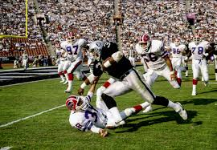
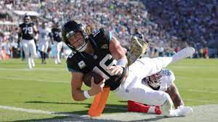
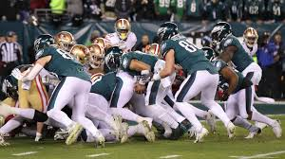
Menu
Players
Teams
Rosters
Week 12 Articles
Run Downhill: Rushing Rate Analysis
Let’s dive into the rushing rates around the NFL and how that relates to win percentage. Fantasy football implications abound!
Authors: Austin Herbert, Keenan Everett
Past
Players
Past Articles
Make the Move: Relocation Analysis
Which team is most likely to relocate this offseason? Who should? Find out which cities we find are safest and which we think would benefit most!
Authors: Bronsin Jabraeili, Marco Khalil, Nicholas Johnson
Push Eagles, Push?: QB Sneak Analysis
How are the Eagles getting away with this Tush Push? Let’s look at the average yards for QB sneaks and the average yards for Jalen Hurts’s touchdowns.
Authors: D’andre Brown, Kenneth Smith

